Slide 1

DBMS UNIT-1

Slide 2
DBMS
DATABASE MANAGEMENT SYSTEM
Books:
Database System Concepts –Henry F.Korth, Silberschatz

Slide 3
DBMS
Data-facts that can be recorded
Facts, figures, statistics etc. having no particular meaning (e.g. 1, RAVI, 19 etc).
Database: collection of related data that represent some real-world entities.
Information: we have extract information from data. It is meaning full or Processed data.

Slide 4
DBMS definition
DBMS-A Database Management System (DBMS) is a software system that is designed to manage and organize data in a structured manner.
It allows users to create, modify, and query a database, as well as manage the security and access controls for that database.
DBMS provides an environment to store and retrieve the data in convenient and efficient manner.

Slide 5
A Historical Perspective or History of Data base Systems
Finding information from a huge volume of papers or deleting/modifying an entry is a difficult task in pen and paper based approach.
To overcome the hassles faced in manual record keeping, it is desirable to computerize storage of data.
From the earliest days of computers, storing and manipulating data have been a major application focus.
In the late 1960s, IBM developed the Information Management System (IMS) DBMS, used even today in many major installations.
IMS formed the basis for an alternative data representation framework called the hierarchical data model.
In 1970, Edgar Codd, at IBM's San Jose Research Laboratory, proposed a new data representation framework called the relational data model.
In the 1980s, the relational model consolidated its position as the dominant DBMS paradigm, and database systems continued to gain widespread use.

Slide 6
A Historical Perspective or History of Data base Systems
SQL was standardized in the late 1980s, and the current standard, SQL: 1999, was adopted by the American National Standards Institute (ANSI) and International Organization for Standardization (ISO).
Specialized systems have been developed by numerous vendors for creating data warehouses, consolidating data from several databases, and for carrying out specialized analysis.
Commercially, database management systems represent one of the largest and most vigorous market segments.

Slide 7
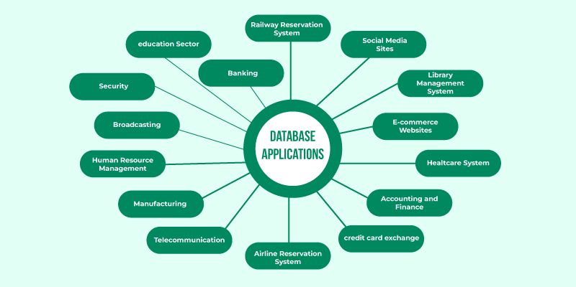
DBMS APPLICATIONS

Slide 8
What is a File System?
This is a traditional mechanism which is used to store data or information in individual unrelated files.
These files are also called as Flat Files. A way to store and manage data in files on a storage device used by the operating system to organize and retrieve files
Examples: FAT32, NTFS, ext4
FAT(File Allocation Table 32) ,NTFS-New Technology File System, Ext4-extended File system

Slide 9
Drawbacks of using file systems to store data
Data redundancy and inconsistency
Multiple file formats, duplication of information in different files
Difficulty in accessing data
Need to write a new program to carry out each new task
Data isolation — multiple files and formats
Integrity problems
Integrity constraints (e.g., account balance > 0) become “buried” in program code rather than being stated explicitly
Hard to add new constraints or change existing ones

Slide 10
Cont…
Atomicity of updates
Failures may leave database in an inconsistent state with partial updates carried out
Example: Transfer of funds from one account to another should either complete or not happen at all
Concurrent access by multiple users
Concurrent access needed for performance
Uncontrolled concurrent accesses can lead to inconsistencies
Example: Two people reading a balance (say 100) and updating it by withdrawing money (say 50 each) at the same time
Security problems
Hard to provide user access to some, but not all, data

Slide 11
Feature | File System | DBMS
Data Storage | Flat file | Tables (rows & columns)
Access Method | Manual or custom code | SQL & APIs
Security | OS-level | User roles, permissions
Redundancy | High | Low (via normalization)
Data Integrity | Manual enforcement | Constraints, rules
Query Support | Not built-in | Advanced SQL querying
Backup & Recovery | Manual | Built-in features

Slide 12
File System | Database Management System (DBMS)
1. It is a software system that manages and controls the data files in a computer system. | 1. It is a software system used for creating and managing the databases. DBMS provides a systematic way to access, update, and delete data.
2. File system does not support multi-user access. | 2. Database Management System supports multi-user access.
3. Data consistency is less in the file system. | 3. Data consistency is more due to the use of normalization.
4. File system is not secured. | 4. Database Management System is highly secured.
5. File system is used for storing the unstructured data. | 5. Database management system is used for storing the structured data.
6. In the file system, data redundancy is high. | 6. In DBMS, Data redundancy is low.
7. No data backup and recovery process is present in a file system. | 7. There is a backup recovery for data in DBMS.
8. Cost of a file system is less than the DBMS. | 9. Cost of database management system is more than the file system.
9. If one application fails, it does not affect other application in a system. | 10. If the database fails, it affects all application which depends on it.
10. In the file system, data cannot be shared because it is distributed in different files. | 11. In DBMS, data can be shared as it is stored at one place in a database.
11. These system does not provide concurrency facility. | 12. This system provides concurrency facility.
12. Example: NTFS (New technology file system), EXT (Extended file system), etc. | 13. Example: Oracle, MySQL, MS SQL Server, DB2, Microsoft Access, etc.

Slide 13
Data Models
A data model in Database Management Systems (DBMS) is a conceptual framework that describes how data is structured, organized, and manipulated within a database.
It defines the rules and conventions for representing and working with data, serving as a blueprint for database design.
Data Models are mainly useful in order to design Data Base
Data Model is the modeling of the data description, data semantics, and consistency constraints of the data.
Relational model
Entity-Relationship data model (mainly for database design)
Object-Oriented data models (Object-oriented and Object-relational)
Other older models:
Network model
Hierarchical model

Slide 14
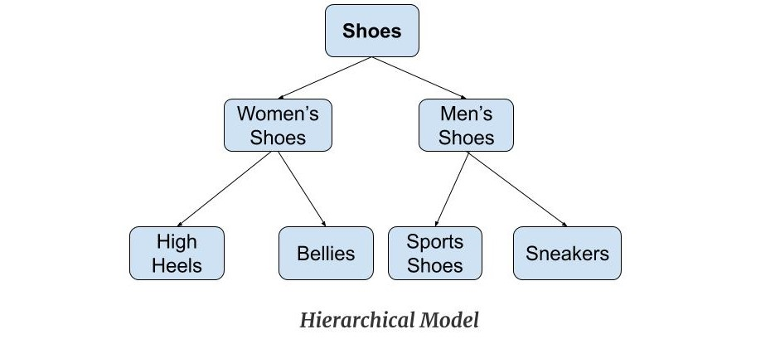
Hierarchical Model
Hierarchical Model was the first DBMS model.
This model organizes the data in the hierarchical tree structure.
The hierarchy starts from the root which has root data and then it expands in the form of a tree adding child node to the parent node.
This model easily represents some of the real-world relationships like food recipes, sitemap of a website etc.

Slide 15
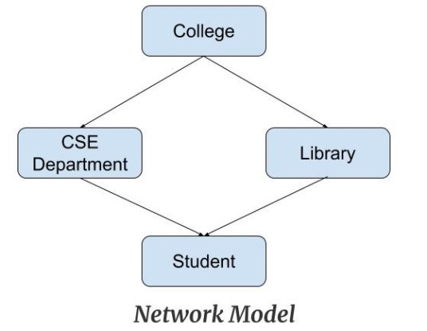
Network Model
This model is an extension of the hierarchical model.
It was the most popular model before the relational model.
This model is the same as the hierarchical model;
The only difference is that a record can have more than one parent.
It replaces the hierarchical tree with a graph.
Example: In the example below, we can see that node student has two parents i.e. CSE Department and Library. This was earlier not possible in the hierarchical model.

Slide 16
Entity-Relationship Data Model
Entity-Relationship Data Model: An ER model is the logical representation of data as objects and relationships among them. These objects are known as entities, and relationship is an association among these entities.
For example, student_name, student_id describes the 'student' entity.
A set of the same type of entities is known as an 'Entity set', and the set of the same type of relationships is known as 'relationship set'.

Slide 17
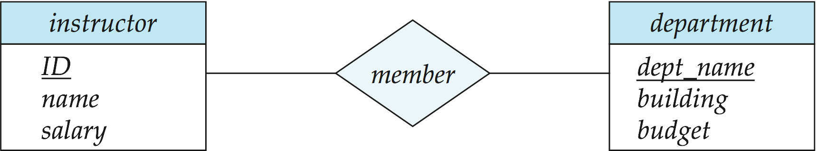
Cont..
Models an enterprise as a collection of entities and relationships
Entity: a “thing” or “object” in the enterprise that is distinguishable from other objects
Described by a set of attributes
Relationship: an association among several entities
Represented diagrammatically by an entity-relationship diagram:

Slide 18
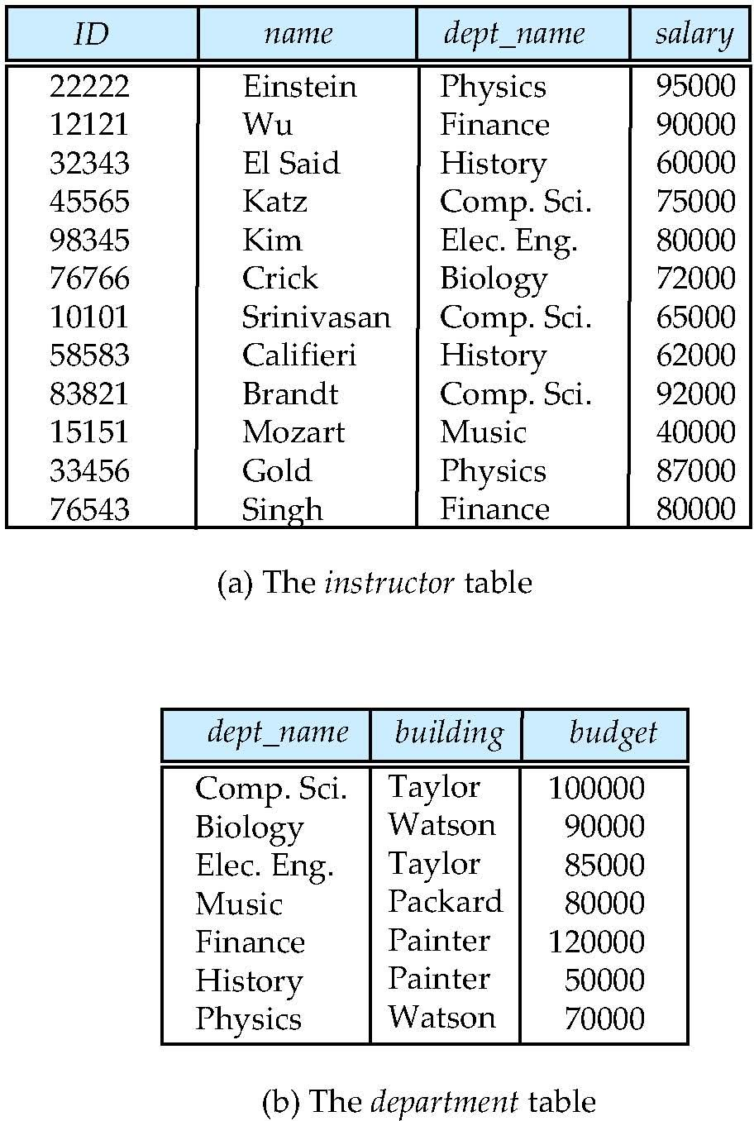
Relational Data Model
Relational Data Model: This type of model designs the data in the form of rows and columns within a table. Thus, a relational model uses tables for representing data and in-between relationships. Tables are also called relations.
Column
ROWS

Slide 19
Object-based Data Model
The real-world problems are more closely represented through the object-oriented data model.
In this model, both the data and relationship are present in a single structure known as an object.
We can store audio, video, images, etc in the database which was not possible in the relational model.
In this model, two are more objects are connected through links. We use this link to relate one object to other objects.

Slide 20
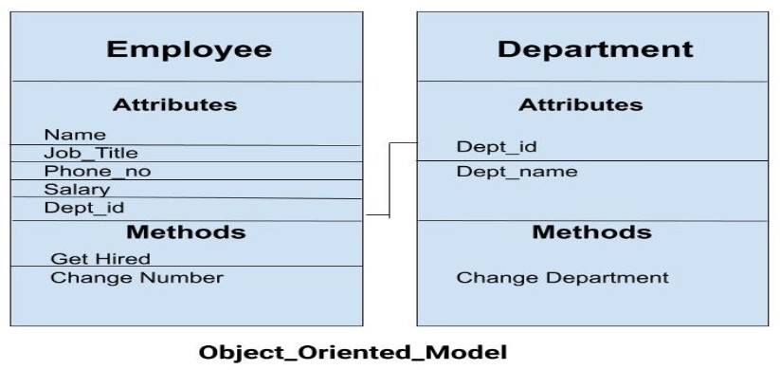
This can be understood by the example given below.

Slide 21
Database Design
The process of designing the general structure of the database:
Requirement Analysis
Conceptual database design
Logical database design
Schema refinement
Physical database design
Security design

Slide 22
Requirement Analysis
What kind of data to store
What are the most performed Operations on the data stored in database
What functionalities to support
Gather business rules and user requirements.
Identify what data needs to be stored, processed, and retrieved.
Interview stakeholders and study existing systems (if any).
Purpose-Understand the data needs of users and the system.

Slide 23
Conceptual database design
Requirement Specifications are converted in to E-R Model or any other similarly High-Level Data Model.
Developer Identify the Entities Relationship between them
Create an Entity-Relationship Diagram (ERD) or UML class diagram.
Purpose-Create a high-level data model without considering the database system.
Deliverable: Conceptual schema (e.g., ERD)

Slide 24
Logical database design
Convert the conceptual model into a logical structure that can be implemented in a database system.
Map entities and relationships into tables.
Define primary keys and foreign keys.
Normalize tables to eliminate redundancy (up to 3NF or higher).

Slide 25
Schema refinement
In this refinement step collection of relations in the relational database schema are Analyzed.
Such as Redundancy, inconsistence, anomalies and restructure.

Slide 26
Physical database design
Concerned about determine the Physical features of the Database
Choose indexes for faster access.
Define data types and storage formats.
Estimate storage size and plan disk usage.
Access methods
Plan for performance optimization.
Purpose: Define how the data will be stored and accessed physically in the database.

Slide 27
Security
All the entities and its roes are identified for every application that access the database.

Slide 28
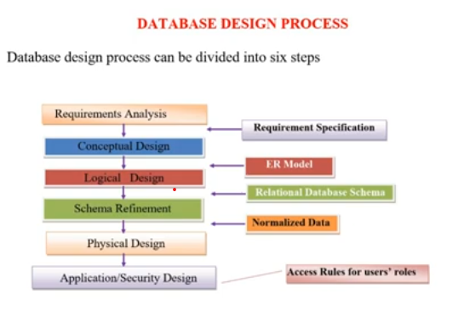

Slide 29
ER (Entity Relationship) Model
ER model stands for an Entity-Relationship model.
It is a high-level data model.
E-R Model is a Graphical Representation of entities and relationship among the entities
It develops a conceptual design for the database.
In ER modeling, the database structure is portrayed as a diagram called an entity-relationship diagram.

Slide 30
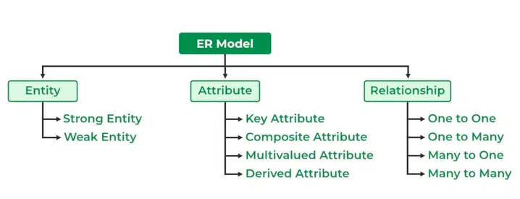
Components of ER Diagram

Slide 31
E-R Model
Entity:
Entity is a thing or Object that is Distinguishable from other Objects
An entity may be any object, class, person or place. In the ER diagram, an entity can be represented as rectangles.
a. Strong Entity Type: Strong entity are those entity types which has a key attribute. The primary key helps in identifying each entity uniquely.
b. Weak Entity Type:
An entity that depends on another entity called a weak entity. The weak entity doesn't contain any key attribute of its own. The weak entity is represented by a double rectangle.

Slide 32
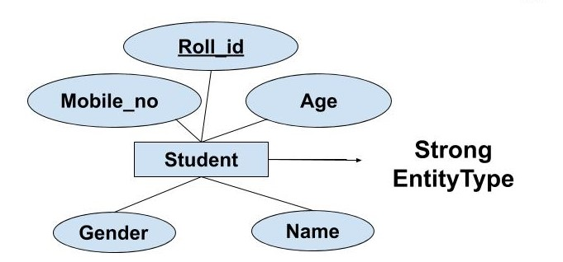
Types of Entity type
Strong Entity Type
Weak Entity Type
Strong Entity Type: Strong entity are those entity types which has a key attribute. The primary key helps in identifying each entity uniquely. It is represented by a rectangle. In the below example, Roll_no identifies each element of the table uniquely and hence, we can say that STUDENT is a strong entity type

Slide 33
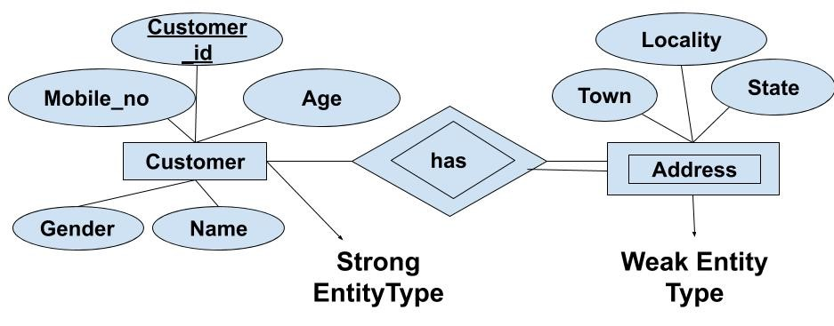
Weak Entity Type: Weak entity type doesn't have a key attribute. Weak entity type can't be identified on its own. It depends upon some other strong entity for its distinct identity.
Every weak entity should have total participation
Entity set maynot have sufficient attributes to form a primary key
Two weak entity sets is not possible to relate each other.
Entity se with no proper candidate key

Slide 34
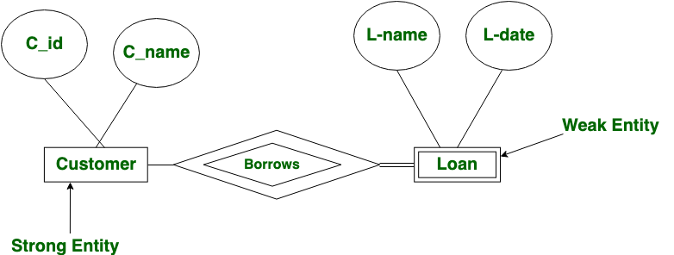
Weak Entity Example

Slide 35
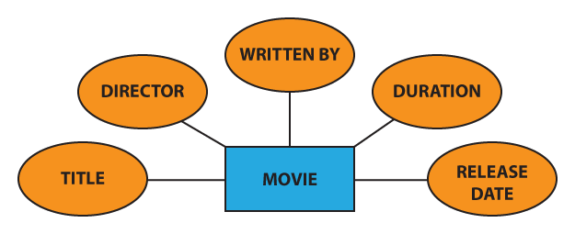
Attribute
The attribute is used to describe the property of an entity. Eclipse is used to represent an attribute.
For example, id, age, contact number, name, etc. can be attributes of a student.

Slide 36
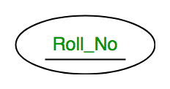
Key Attribute
The attribute which uniquely identifies each entity in the entity set is called the key attribute.
For example, Roll_No will be unique for each student. In ER diagram, the key attribute is represented by an oval with underlying lines.

Slide 37
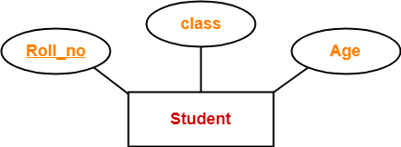
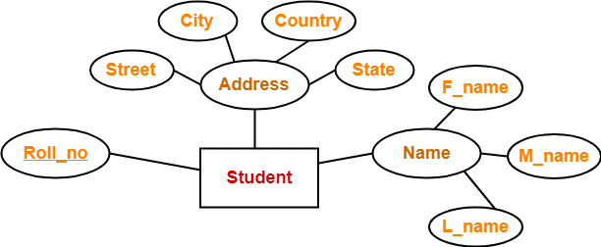
Simple attribute- Is one which cannot be divided further(Atomic)
Composite attribute -Composite attributes are those attributes which are composed of other simple attributes

Slide 38
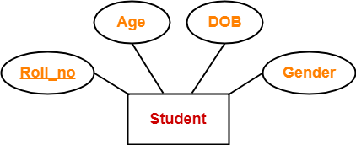
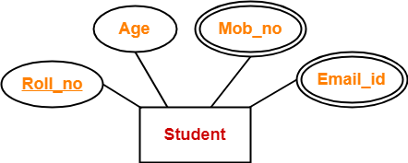
Single valued attributes - Are those attributes that can take only one value for a given entity.
Multi valued attribute - Multi valued attributes are those attributes which can take more then one value for a given entity.

Slide 39
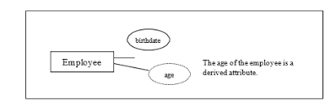
Stored attribute: these attributes which are stored physically in the data base.
Examples:-mobile no, person details , name, mail id
Derived attribute:- These attributes not stored physically in the data base.
Which are derived from other entities like age derived from DOB.
Example- Avg salary it is derived from Salary

Slide 40
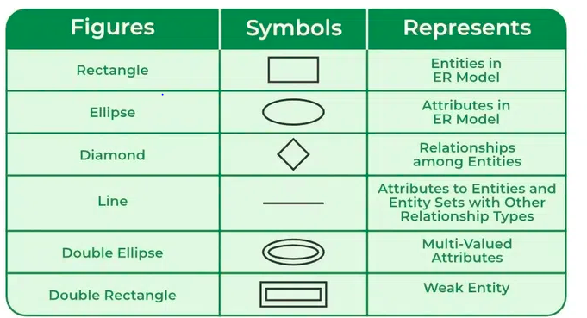
Symbols Used in ER Model

Slide 41
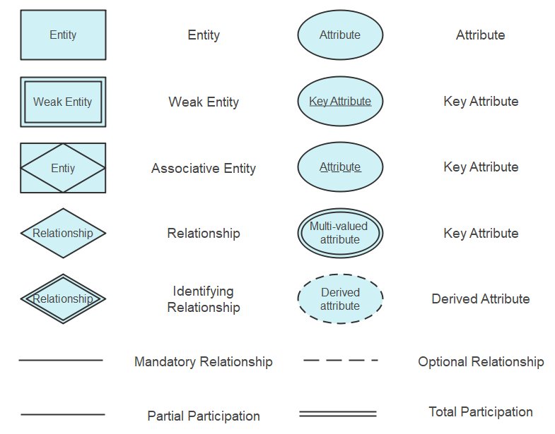

Slide 42
Relationships and Relationship sets
Relationship
The association among two or more entities is called a relationship. For example, an employee works_in department.
A relationship is represented by diamond shape in ER diagram, it shows the relationship among entities.
Relationship Set
A relationship set is a collection of similar relationships. Like entities, a relationship too can have attributes. These attributes are called descriptive attributes.
NOTE:
Schema – specifies relation name,attribute,column or field name and domain
name(values)
Instance – it is the collection of information stored in database at particular moment

Slide 43
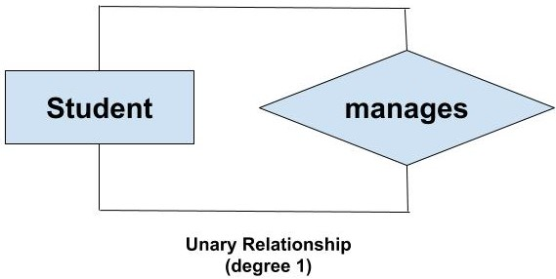
Degree of Relationship
It is the total number of entities that participate in a relationship.
Degree of a relation is no. of fields/attributes
Unary relationship – relationship between instances of same entity class
It is also called as Recursive Relationship.
Unary Relationship =degree 1

Slide 44

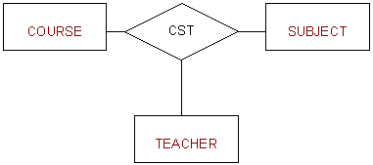
Binary relationship - relationship between instances of 1 entity class with instances of another entity class
Binary relationship = degree 2
Ternary relationship - relationship between instances of 3 entity class with one another
Ternary relationship = degree 3

Slide 45
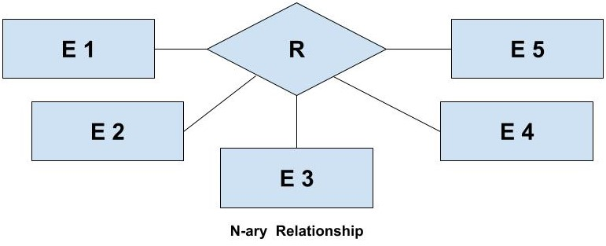
N-ary relationship - relationship between instances of n entity class with one another
n-ary Relationship = degree n

Slide 46
What is Cardinality?
It is the no. of instances of one entity class that can be associated with each instance of another entity class.
. Cardinality can be of different types:
1. One-to-One
2. One-to-Many
3.Many-to-One
4.Many-to-Many

Slide 47
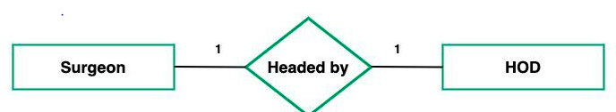
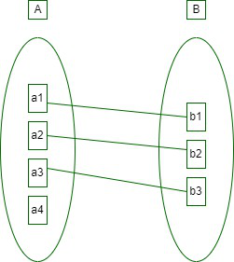
One-to-One
When each entity in each entity set can take part only once in the relationship, the cardinality is one-to-one. Let us assume that a male can marry one female and a female can marry one male. So the relationship will be one-to-one.

Slide 48
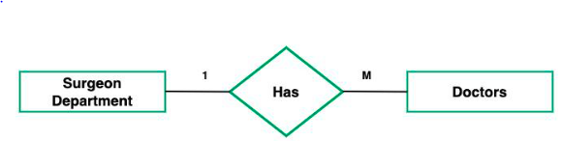
One-to-Many
In one-to-many mapping as well where each entity can be related to more than one entity.
Let us assume that one surgeon department can accommodate many doctors. So the Cardinality will be 1 to M.
It means one department has many Doctors.

Slide 49
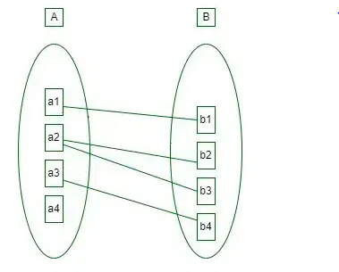
One-to-Many
Using sets, one-to-many cardinality can be represented as:

Slide 50
Many-to-One
When entities in one entity set can take part only once in the relationship set and entities in other entity sets can take part more than once in the relationship set, cardinality is many to one.
Let us assume that a student can take only one course but one course can be taken by many students.
So the cardinality will be n to 1.
It means that for one course there can be n students but for one student, there will be only one course.

Slide 51
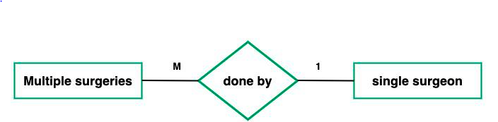
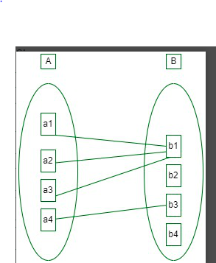
Many-to-One
Using Sets, it can be represented as:

Slide 52
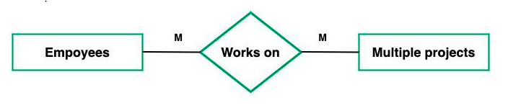
Many-to-Many:
When entities in all entity sets can take part more than once in the relationship cardinality is many to many.
Let us assume that a student can take more than one course and one course can be taken by many students. So the relationship will be many to many.

Slide 53
key
Primary Key: A unique identifier for each record in a table.
Foreign Key: A field in another table that references the primary key of the first table.

Slide 54
ADDITIONAL FEATURES OF E-R MODEL
Key constraints
Participation Constraints- will be two types
1.Total Participation
2.Parital Participation
Class hierarchies –can be views in one of two ways
1.Specialization
2.Generalization
Aggregation

Slide 55
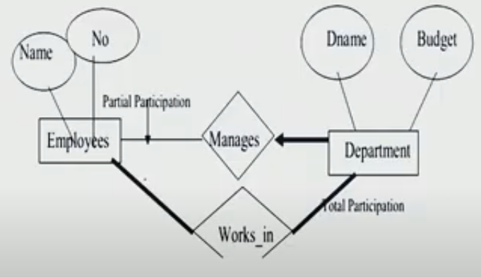
Total participation- in an Entity set each and every entity participating in a relationship it is called total participation else called partial participation
Total Participation Partial Participation

Slide 56
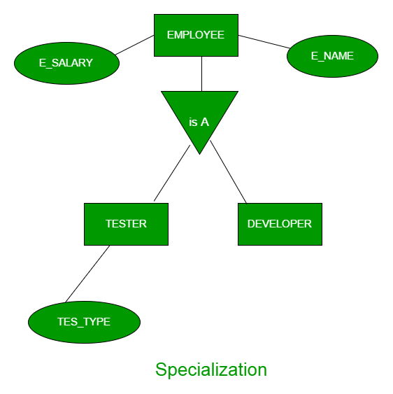
Specialization
Specialization is a process of identifying subset of an entity that shares different Characteristics
It breaks an entity into multiple entities from higher level to lower level.
Here, superclass is defined first and then subclass is defined next followed by superclass specific attributes and relationship sets are added.
it Top-down approach

Slide 57
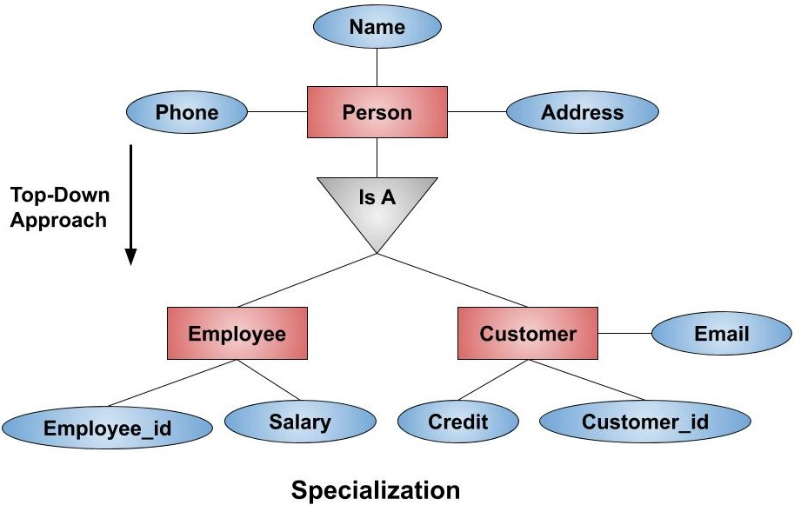

Slide 58
Generalization
identifying some common characteristics of collection of entity sets and creating a new entity set that contains entities with common characteristics.
Here, subclass is defined first and then superclass is defined next followed by relationship that involves the superclass are then defined. it bottom-up approach

Slide 59
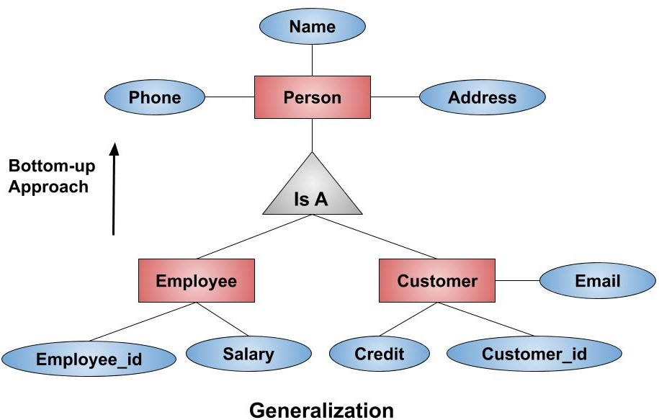

Slide 60
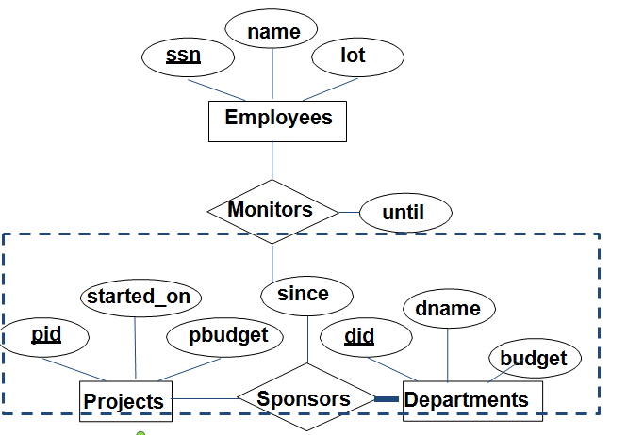
Aggregation
it is a process when relation between two entities is treated as single entity.
Relationship set participate in another relationship set. We can use either aggregation or ternary relationship for 3 or more entity sets . Denoted by dashed box.

Slide 61
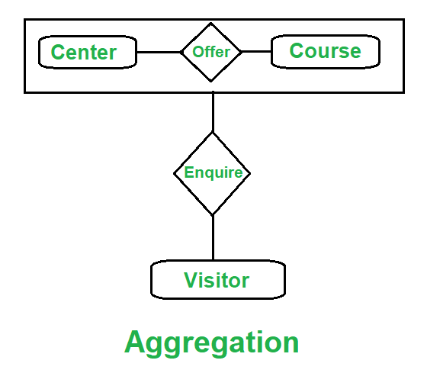

Slide 62
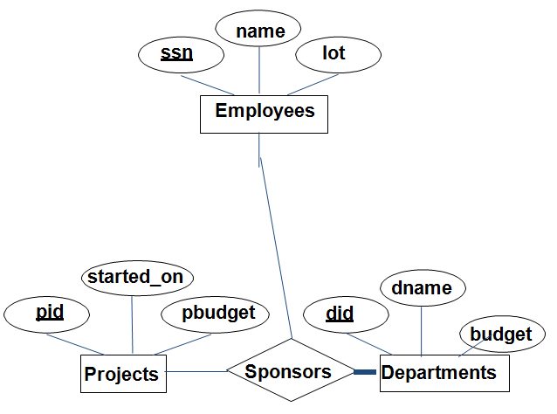
A descriptive attribute is a non-key attribute that holds descriptive or informational data about an entity, without playing a role in the entity's identity.

Slide 63
SQL
SQL stands for Structured Query Language or sequel
SQL is declarative language
It is a command-based language
It is not case sensitive.
Every command should end with ‘;’
SQL is used to access & manipulate data in databases
It is similar to English. This language is developed in the year 1972 by “IBM”.
Top SQL DBs are MS SQL Server, Oracle, DB2, and MySQL

Slide 64
Database Languages
DDL (Data Definition Language)
DML (Data Manipulation Language)
TCL (Transaction Control Language)
DCL (Data Control Language)

Slide 65
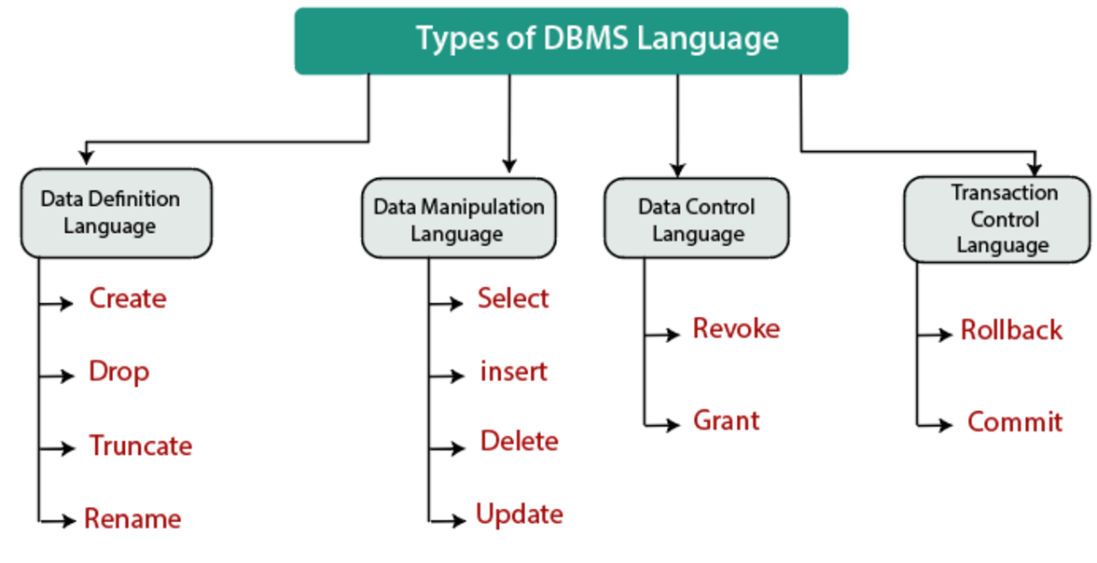

Slide 66
DDL(Data Definition Language)
This language is used to manage database objects such as table and view.
CREATE - creates a new table or a view of a table in database
ALTER – modifies contents of a table.(COLUMN)
DROP - deletes an entire table or a view of a table
TRUNCATE – delete all rows(values) from table
RENAME – renames the table name

Slide 67
DML(Data Manipulation Language)
This language is used to manipulate the data .
INSERT – inserts data into table
UPDATE – update/modifies data in the table(ROWS)
DELETE - deletes data from table
DQL-This language is used to retrieve the data from the table
SELECT – retrieve the data from the table

Slide 68
TCL(Transaction Control Language)
This language is used to maintain the transaction of database
COMMIT
ROLLBACK
SAVEPOINT

Slide 69
DCL(Data Control Language)
This language is used to control the access of the data to the users
GRANT - assign privilege
REVOKE - remove privilege

Slide 70
DBMS ARCHITECTURE
Types of DBMS Architecture
Three Schema Architecture of DBMS
Data Independence

Slide 71
DBMS ARCHITECTURE
DBMS Architecture refers to the overall design and organization of a database management system (DBMS), including the hardware, software, data, and personnel components.
It defines the way data is stored, processed, and retrieved from the database.

Slide 72
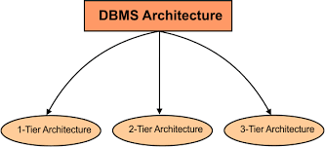
Types of DBMS Architecture
1. Single Tier Architecture (One-Tier Architecture)
2. Two-Tier Architecture
3. Three-Tier Architecture

Slide 73
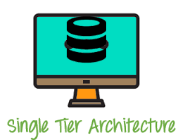
1-Tier Architecture
1-Tier Architecture in DBMS is the simplest architecture of Database in which the client, server, and Database all reside on the same machine.
A simple one tier architecture example would be anytime you install a Database in your system and access it to practice SQL queries.

Slide 74
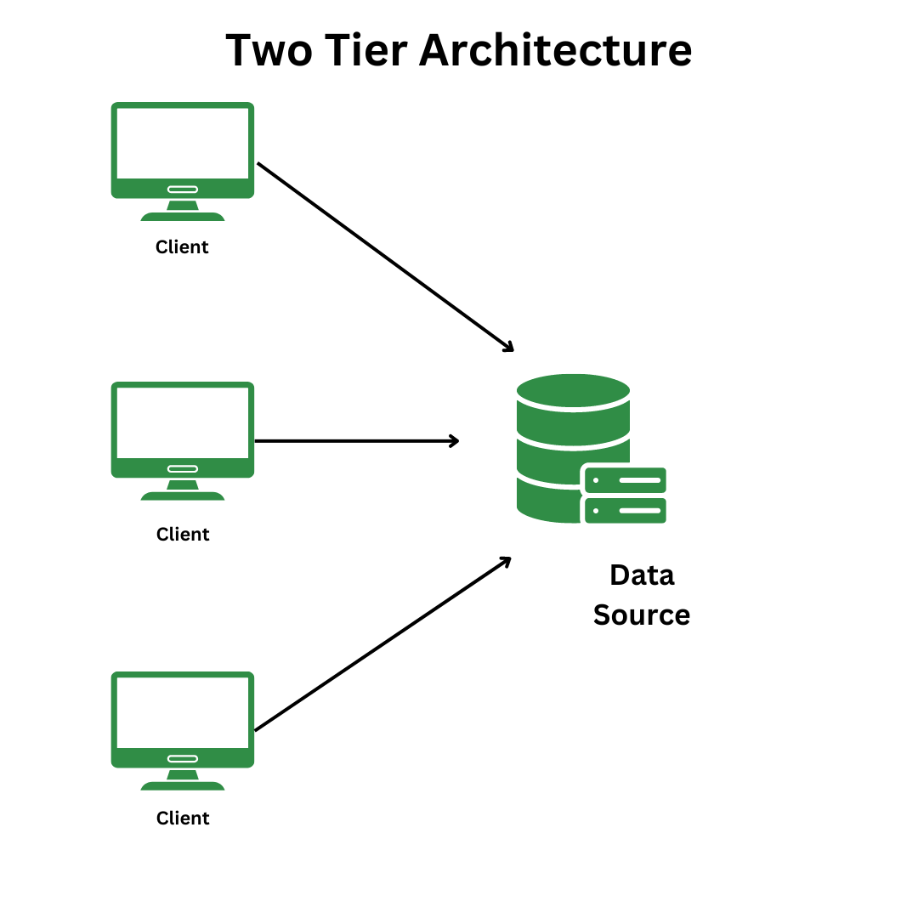
2-Tier Architecture
2-Tier Architecture in DBMS is a Database architecture where the presentation layer runs on a client (PC, Mobile, Tablet, etc.), and data is stored on a server called the second tier. Two tier architecture provides added security to the DBMS as it is not exposed to the end-user directly. It also provides direct and faster communication.
API
API

Slide 75
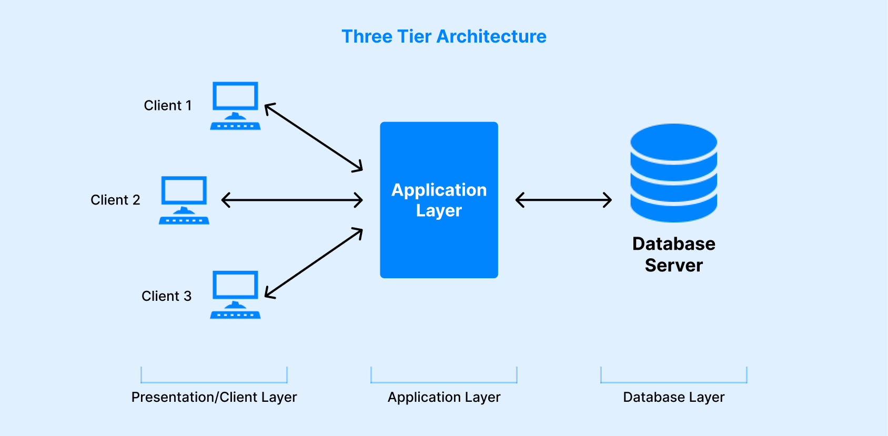
3-Tier Architecture
A 3 Tier Architecture in DBMS is the most popular client server architecture in DBMS in which the development and maintenance of functional processes, logic, data access, data storage, and user interface is done independently as separate modules. Three Tier architecture contains a presentation layer, an application layer, and a database server.

Slide 76
Levels of abstraction
Abstraction-Hiding irrelevant data from set of user and providing abstract view of data User
Three Levels of abstraction
1.Physical Level-(Low Level)-how data or a record is stored in database
2.Logical Level-(Middle Level)-Describes What data stored in database and the relationships among the data.
3.View level-(High level)-Describes the interaction with database System

Slide 77
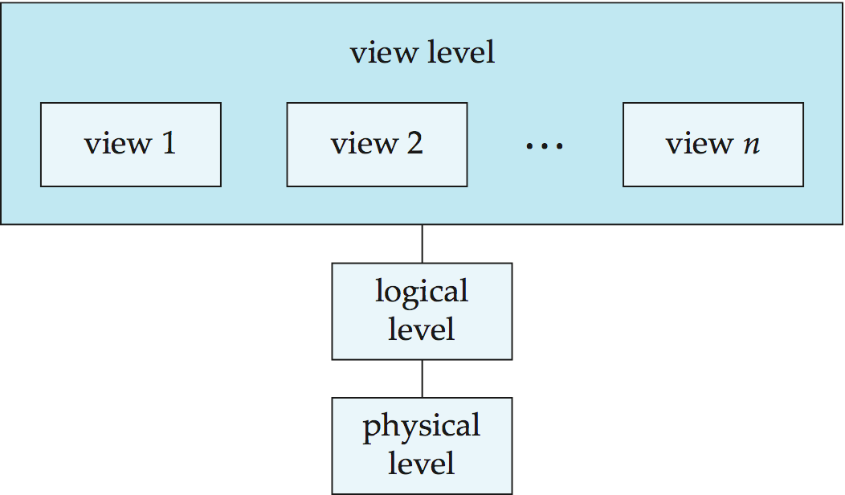
View of Data
An architecture for a database system

Slide 78
Three Schema Architecture of DBMS or logical Architecture of DBMS
The three-schema architecture describes how the data is represented or viewed by the user in the database.
This architecture is also known as three-level architecture or logical architecture and is sometimes called ANSI architecture.
This architecture contains three layers or levels of the database management system:
1.External level
2.Conceptual level
3.Internal level

Slide 79
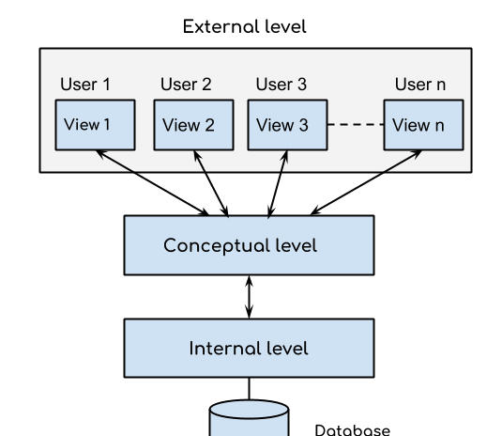

Slide 80
1. External or View level: This is the highest level of database abstraction. External or view level describes the actual view of data that is relevant to the particular user. This level also provides different views of the same database for a specific user or a group of users.
2. Conceptual or Logical level: This level acts as a middle layer between the physical storage and user view. It explains what data to be stored in the database, what relationship exists among those data, and what the data types are.
This schema hides information about the physical storage structures and focuses on describing data types, entities, relationships, etc

Slide 81
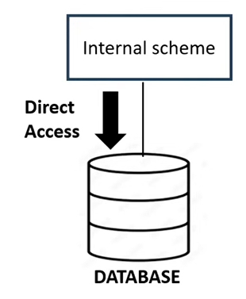
3. Internal or Physical level: This is the lowest level of database abstraction.
It describes how the data is actually stored in the database and provides methods to access data from the database. It allows viewing the physical representation of the database on the computer system .
This level describes how the data is actually stored in the storage devices.
This level is also responsible for allocating space to the data.

Slide 82
Need of Three Schema Architecture
Data Independence
The ability to modify the schema definition of a DBMS at one level, without affecting the schema definition of the next higher level is called data independence.
Types of Data independence
1.Physical Data Independence
2.Logical Data Independence

Slide 83
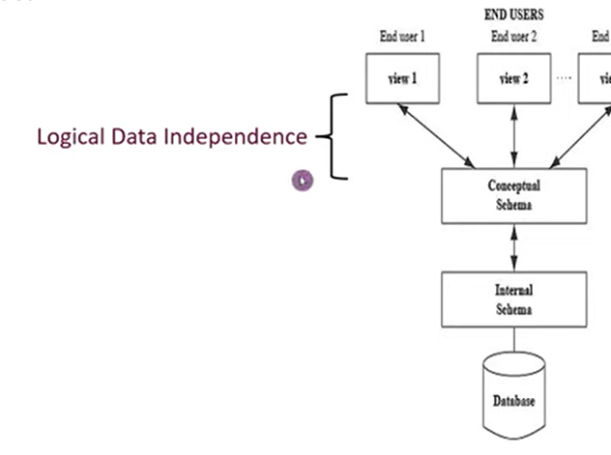
Logical Data Independence
Logical data independence refers characteristic of being able to change the conceptual schema without having to change the external schema.
Example
1.Add / Modify / Delete a new attribute, entity or relationship is possible without a rewrite of existing application programs
2.Merging two Records into one
3.Breaking an existing record into one or more Records

Slide 84
Physical Data Independence
Physical data independence can be defined as the capacity to change the internal schema without having to change the conceptual schema.
Example
1. Using a new storage device like Hard Drive or Magnetic Tapes
2. Modifying the file organization technique in the Database
3. Modifying indexes.
4. Change of Location of Database from say C drive to D Drive

Slide 85
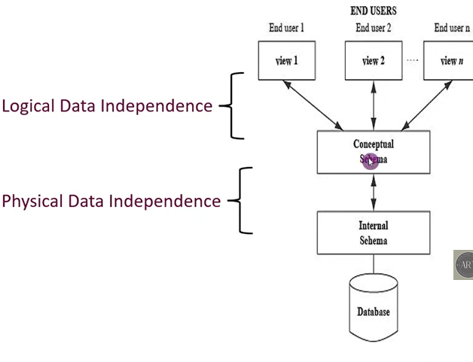

Slide 86
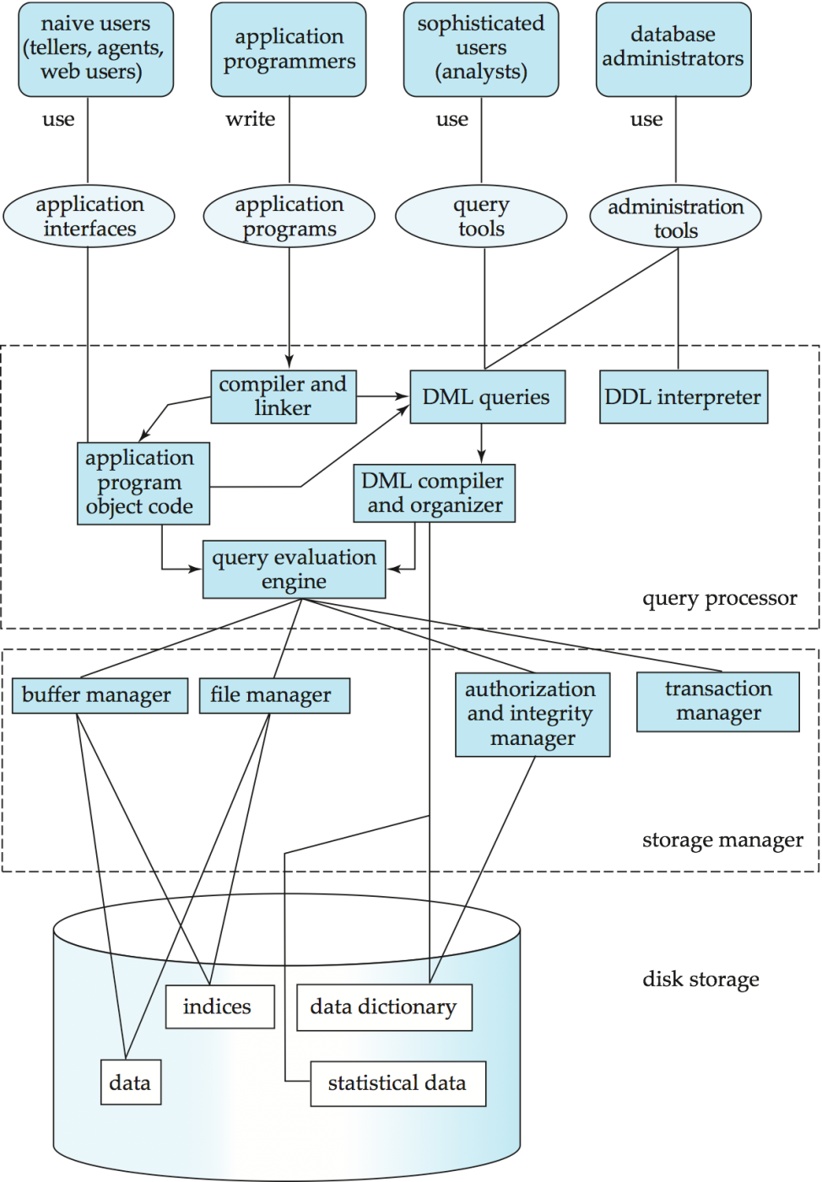
Structure of DBMS

Slide 87
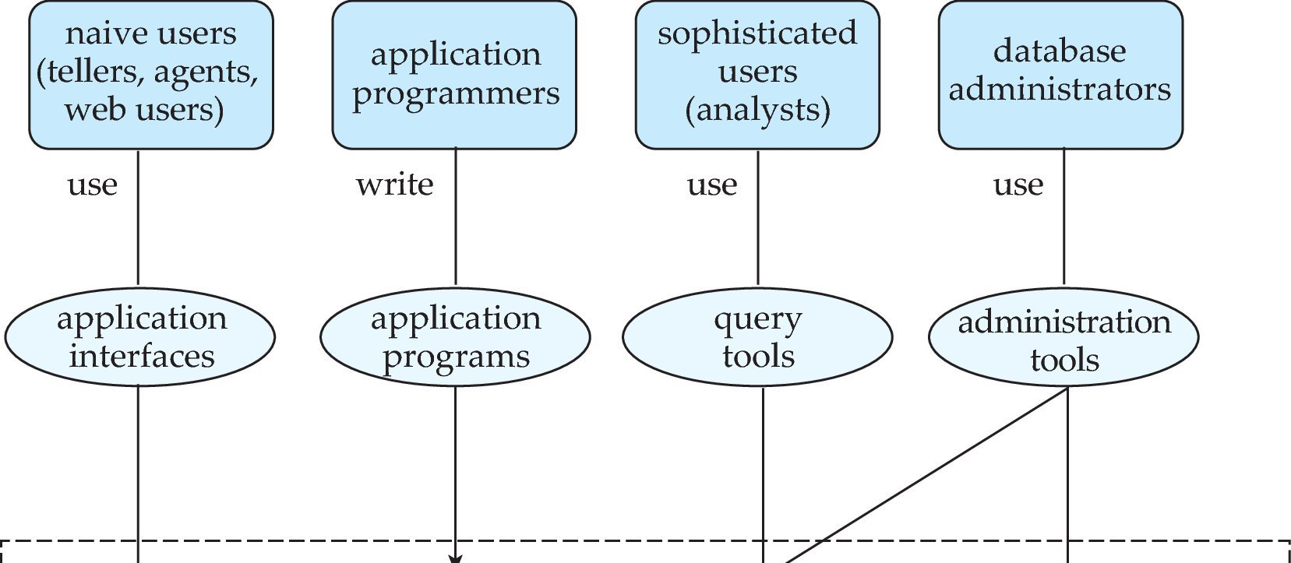
Database Users and Administrators
Database

Slide 88
Database Users
Users are differentiated by the way they expect to interact with the system
Application programmers – interact with system through DML calls .
Sophisticated users – form requests in a database query language
Specialized users – write specialized database applications that do not fit into the traditional data processing framework.
Naïve users – invoke one of the permanent application programs that have been written previously

Slide 89
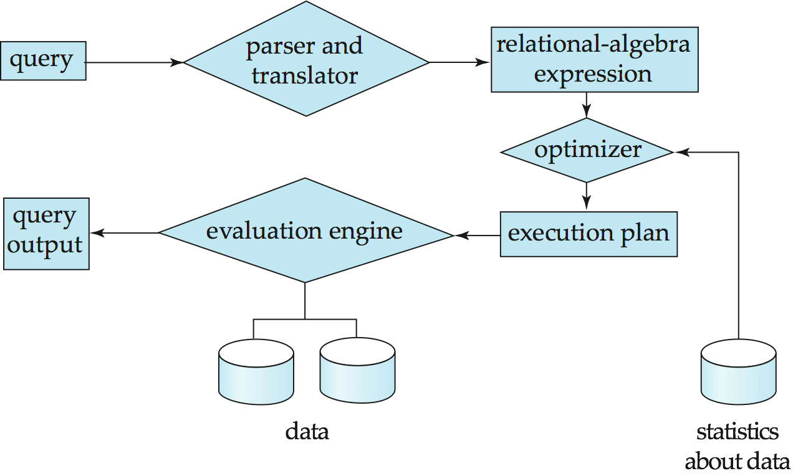
Query Processing
1. Parsing and translation
2. Optimization
3. Evaluation

Slide 90
Storage Management
Storage manager is a program module that provides the interface between the low-level data stored in the database and the application programs and queries submitted to the system.
The storage manager is responsible to the following tasks:
Interaction with the file manager
Efficient storing, retrieving and updating of data
Issues:
Storage access
File organization
Indexing and hashing

Slide 91
Transaction Management
What if the system fails?
What if more than one user is concurrently updating the same data?
A transaction is a collection of operations that performs a single logical function in a database application
Transaction-management component ensures that the database remains in a consistent (correct) state despite system failures (e.g., power failures and operating system crashes) and transaction failures.
Concurrency-control manager controls the interaction among the concurrent transactions, to ensure the consistency of the database.

Slide 92
Database Administrator(DBA)
A Database Administrator (DBA) is an individual or person responsible for controlling, maintaining, coordinating, and operating a database management system.
Coordinates all the activities of the database system.

Slide 93
Roles & Responsibilities of DBA
Software Installing and configuration of db.
Data Extraction ,Transformation and Loading(ETL)
Data handling
Monitoring Performance
Database Backup and recovery
Database Security
Authentication and Access control
Provides help and support to user.

Slide 94

Software Installing and configuration of db.
A DBA is frequently involved in the initial installation and configuration of a new Oracle, SQL Server, or other databases. The system administrator configures the database server's hardware and implements the operating system, after which the DBA installs and configures the database software.

Slide 95

Data Extraction ,Transformation and Loading(ETL)
DBAs are responsible for Data extraction, transformation, and loading, also known as (ETL), which refers to the efficient import of large amount of data extracted from multiple systems into a data warehouse environment.
The external data is cleaned and transformed to fit the required format before being imported into a central repository.

Slide 96


Data Handling
Each company's success today revolves around massive databases.
Companies nowadays maintain massive databases containing unstructured data types such as images, documents, or sound and video files.

Slide 97

Monitoring Performance
Only implementing a database is not the task of the database administrator.
Once the database is implemented, they are required to monitor databases for performance issues. If a system component slows down processing, the DBA may need to change the software configuration or add more hardware capacity.

Slide 98

Database Backup and recovery
DBAs create backup and recovery plans and procedures as per the industry standards. Not only that, but DBAS make certain that all necessary steps are taken. DBAs are responsible for ensuring that everything is completed on time, in addition to taking the required precautions to keep data safe.

Slide 99

Database Security
One of the most critical responsibilities of a DBA is identifying and correcting any flaws in the database software. No system is entirely secure; however, DBAs mitigate risks by implementing best practices.

Slide 100

Authentication and Access control
Setting up client access is an important aspect of database security. DBAS control who has access and what type of access they are allowed. For instance, a user may have permission to see only certain pieces of information, or they may be denied the ability to make changes to the system.

